Slide 1
CVPR 2021

Slide 2
Outline
Introduction
Method
Experiments
Discussion
Notes:
我从如下几个方面进行介绍。

Slide 3
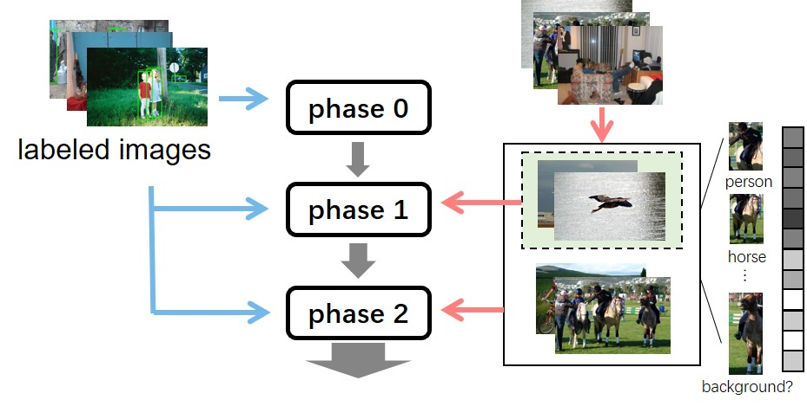
Introduction
1. SSOD exploits a large amount of unlabeled data to boost the performance of fully-supervised object detection especially when only limited labeled data are available.
2. Currently, many SSOD methods are established on pseudo labels and adopt the one-phase learning.
One-phase learning
Multi-phase learning

Slide 4
Introduction
Label Noise Overfitting Problem
• On the image level, some image samples are difficult, resulting in inaccurate pseudo labels and noise to semi-supervised object detection.
• On the region level, pseudo labels (boundary boxes) overlap a lot and carry a lot of noise.

Slide 5
Introduction
How to solve the above problems?
Main contributions:
• We propose an uncertainty guided multi-phase SSOD learning method.
• With image-uncertainty based selection, we alleviate attention imbalance on different difficulty levels of data and are capable of fitting all unlabeled images well.
• With region-uncertainty based RoI reweighting strategy, we exploit it to guide multi-phase learning and assist the detector in focusing on more certain regions.

Slide 6
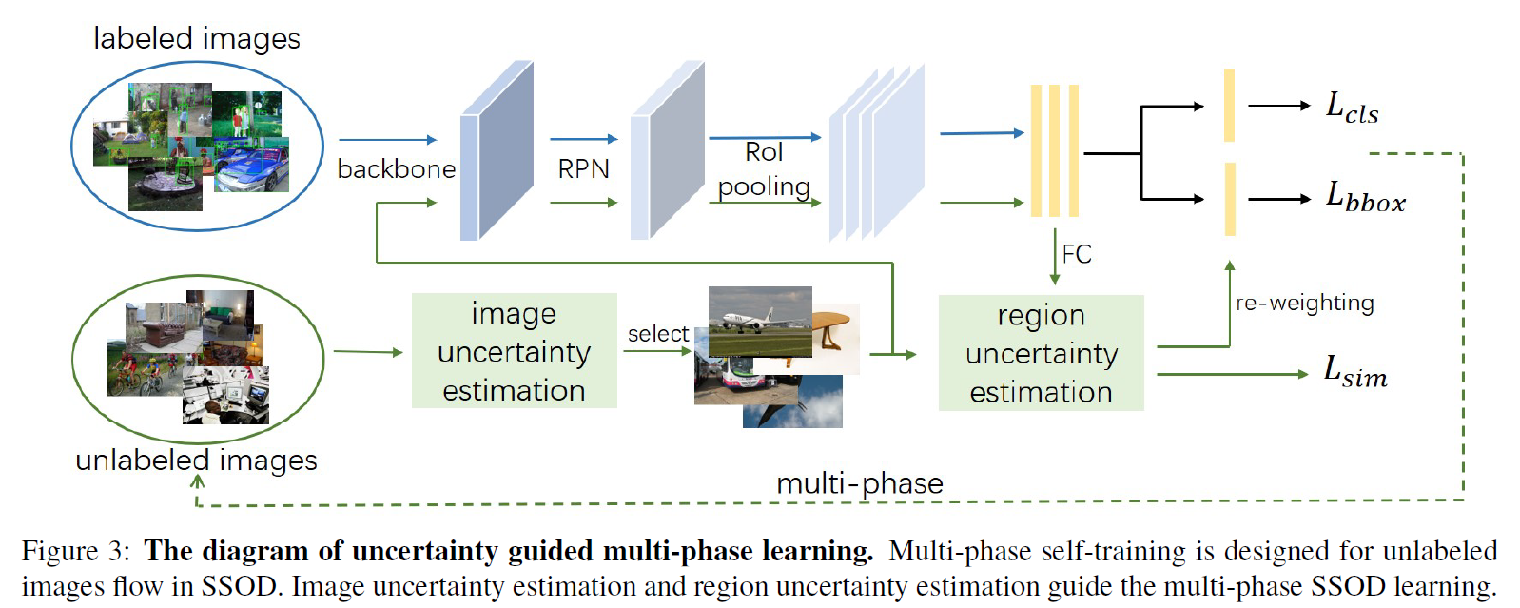
Method
Multi-Phase Learning

Slide 7
Method
Image Uncertainty Guided Selection
Target: Selecting easy images from the unlabeled dataset.
Metric: Guaranteeing that the detection model is more certain about easy images than difficult ones.
Now that we have detected objects(i.e. pseudo labels)
of Image
denotes the bounding boxes
is the corresponding confidence score
is the average of all bounding boxes’scores inside an image measures the certainty deg-
ree of all annotations

Slide 8
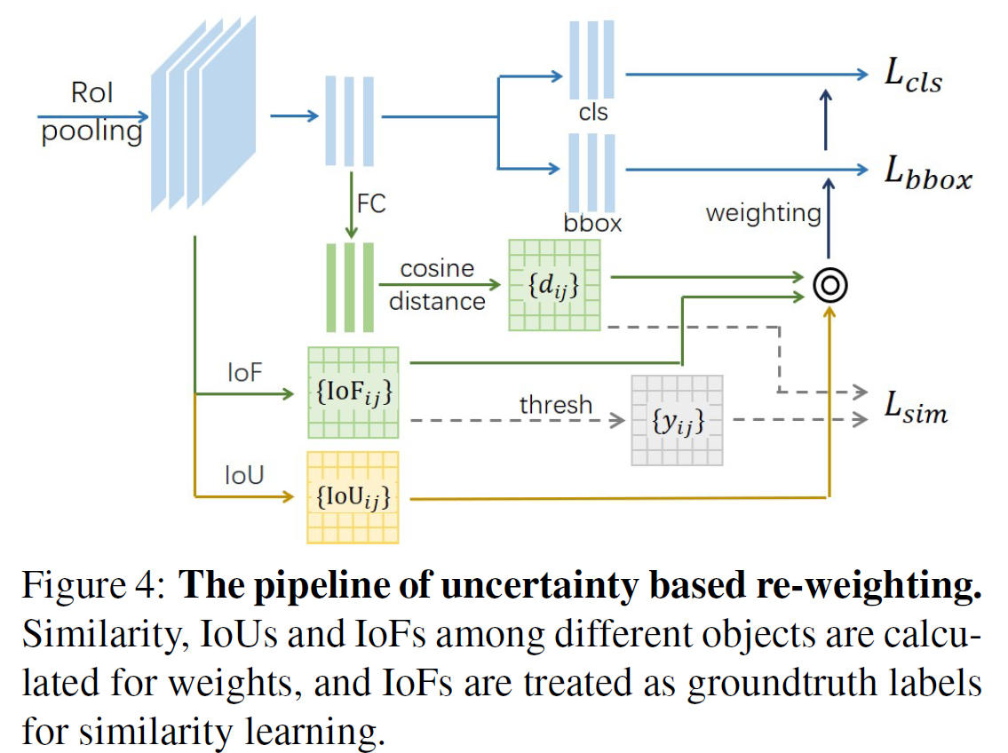
Method
Region Uncertainty Guided RoI Re-weighting
Target: To alleviate the problem that detector is still distracted by noisy regions with missing annotation
overlap based uncertainty:
We adopt Intersection over Union (IoU) as one of the metrics for uncertainty measurement. Overlap based weights are computed as follows:
similarity based uncertainty:
We apply the cosine distance to calculate the similarity between different RoIs.
We combine both cosine distance and IoF for ultimate similarity based uncertainty description:
The ultimate uncertainty based weights are as follows:

Slide 9
Method
Region Uncertainty Guided RoI Re-weighting
Target: To alleviate the problem that detector is still distracted by noisy regions with missing annotation
Considering that a bounding box is highly similar to boxes inside it, we adopt IoF as a supervised signal for similarity learning:
where I(·) is the indicator function, t is a pre-defined thresh.
We set t to 0.7 in all experiments. Ultimately, the loss function for learning similarity is defined as

Slide 10
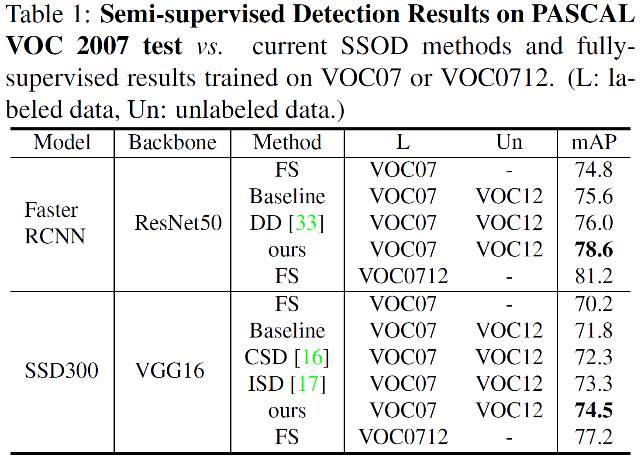
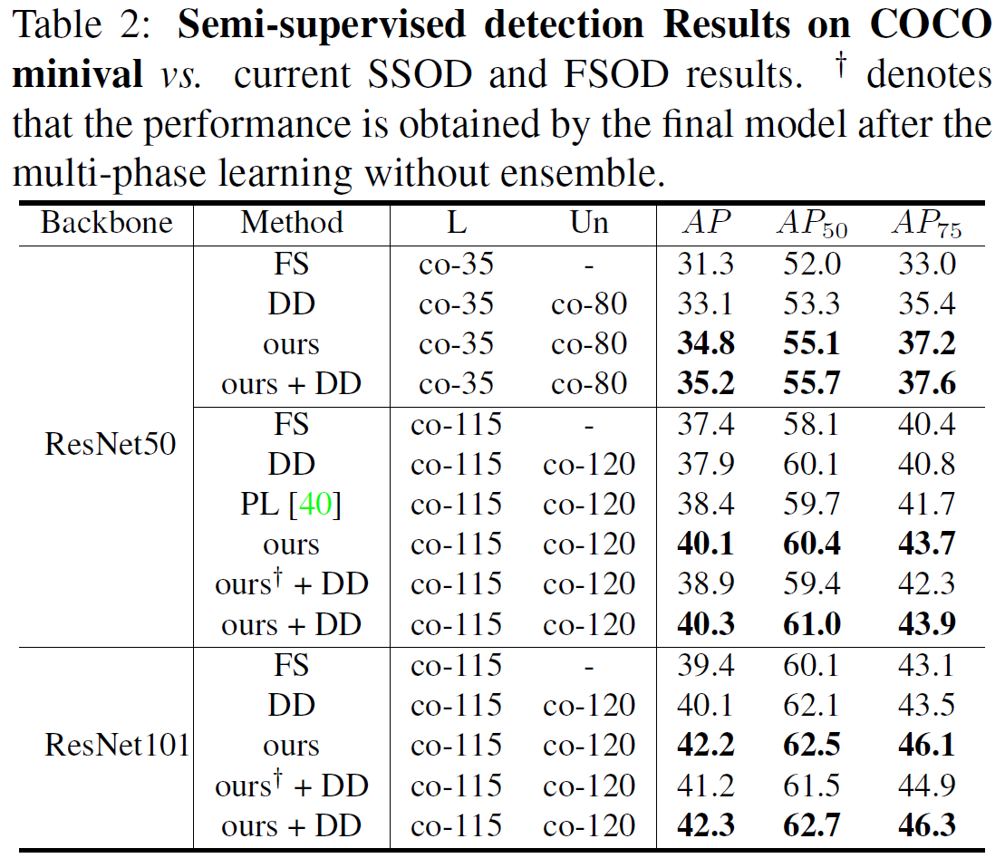
Experiments
Comparison with existing methods

Slide 11
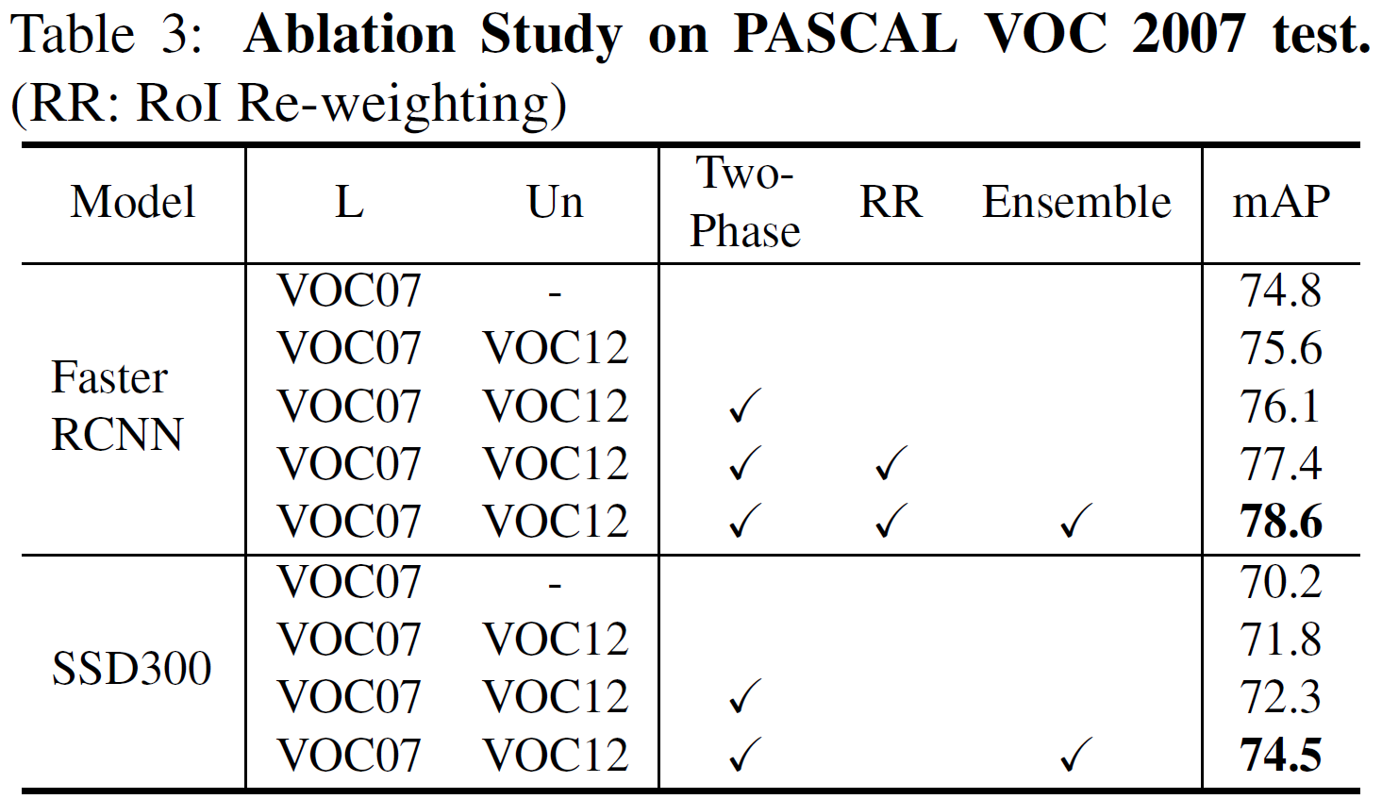
Experiments
Ablation Study:

Slide 12
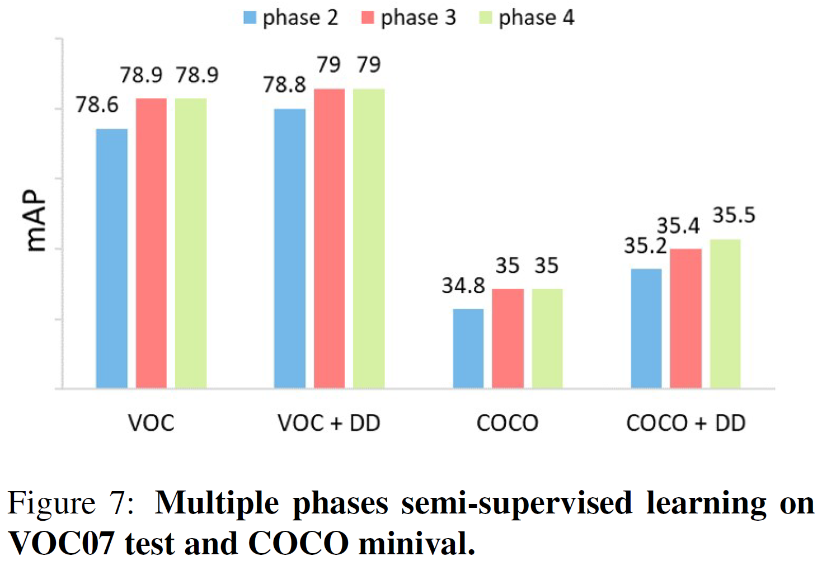
Discussion
More Phases

Slide 13
Thanks

